Slide 1
KodeSPACE
Consolidated Workstation

Slide 2
ToC
Our Team
Our Audience
2
Our Objective
Our Process
3
Our Goal
Future Vision
4
Menu of Solutions
1

Slide 3
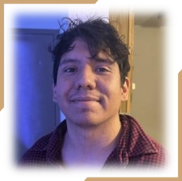
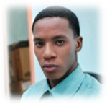
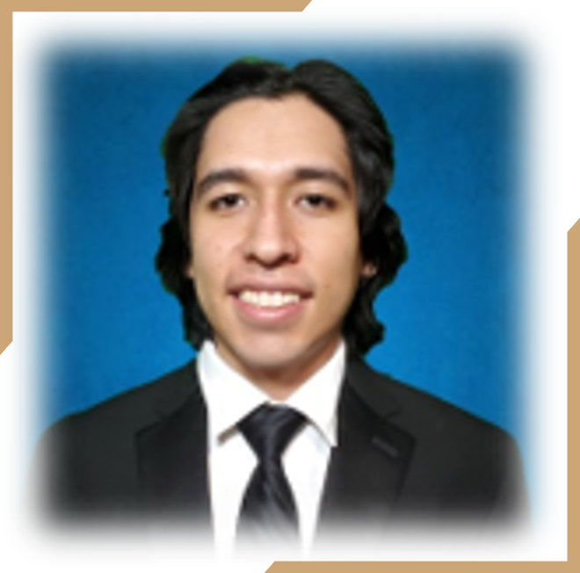
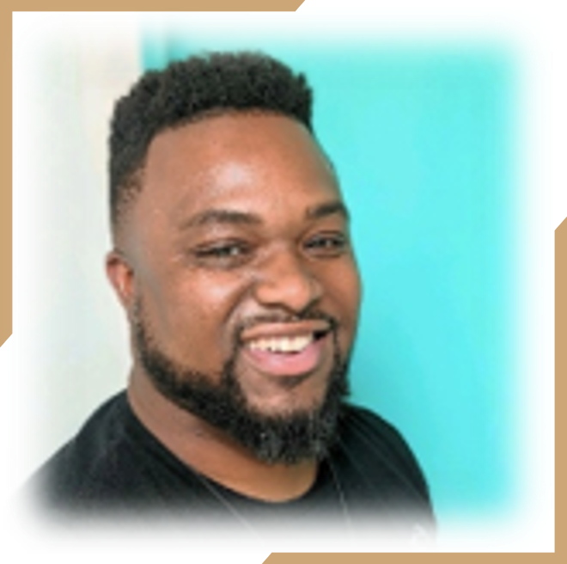
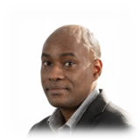
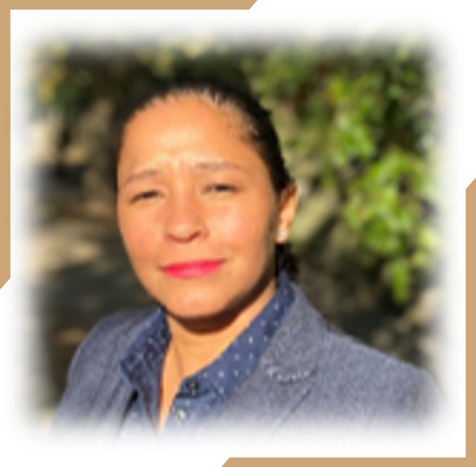
Our Team
Rey Rivera
PM
Caleb Celius
Administrator
Antonio Rios
Chief Architect
KodeSPACE
Michael Major
Engineer
Kerri Smith
Engineer
Lora Lee Barreto
Engineer
CFO

Slide 4
Our Objective
To build a service that hosts a platform of microservices that are combined to make a playground for fledgling developers.
The services are containerized and use ECS, Fargate to provide a serverless infrastructure and auto scale according to user traffic.
Our infrastructure includes Terraform as IaC (Infrastructure as Code) and Docker for configuration of containers.
These tools are hosted within a t2.large EC2 instance.
Production Team
Application Budget
Timeline
6 members
2.5 wks
$200 USD

Slide 5


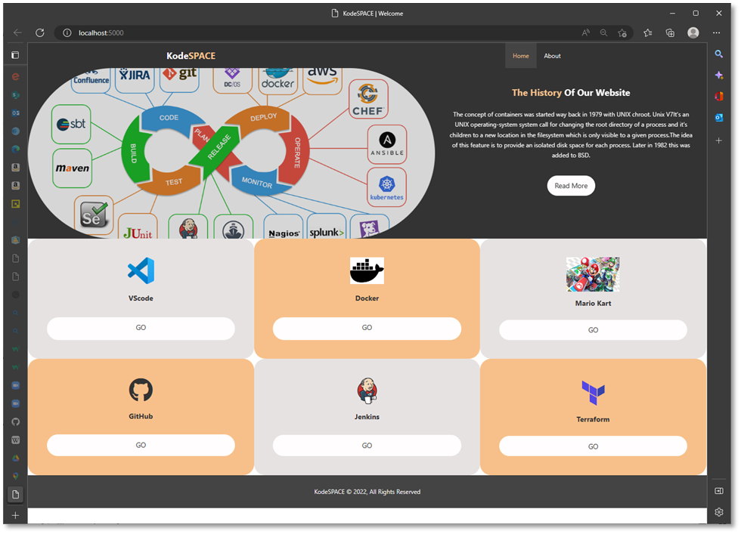
Our Goal
We aim to consolidate your development experience by offering an environment that contains pre-configured tools accessible on-demand from any browser.

Slide 6


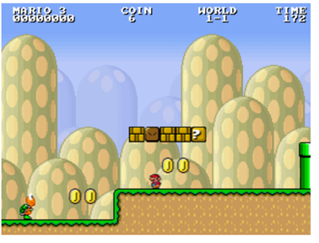



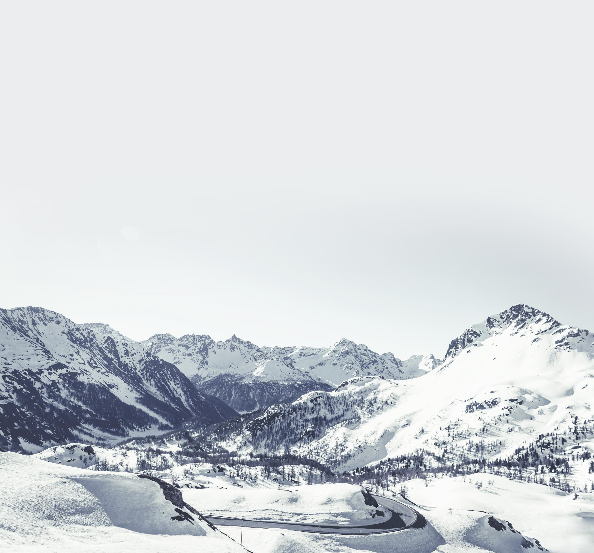
Menu of Solutions
1
VScode
3
Docker
5
Games
2
GitHub
4
Jenkins
6
Terraform

Slide 7


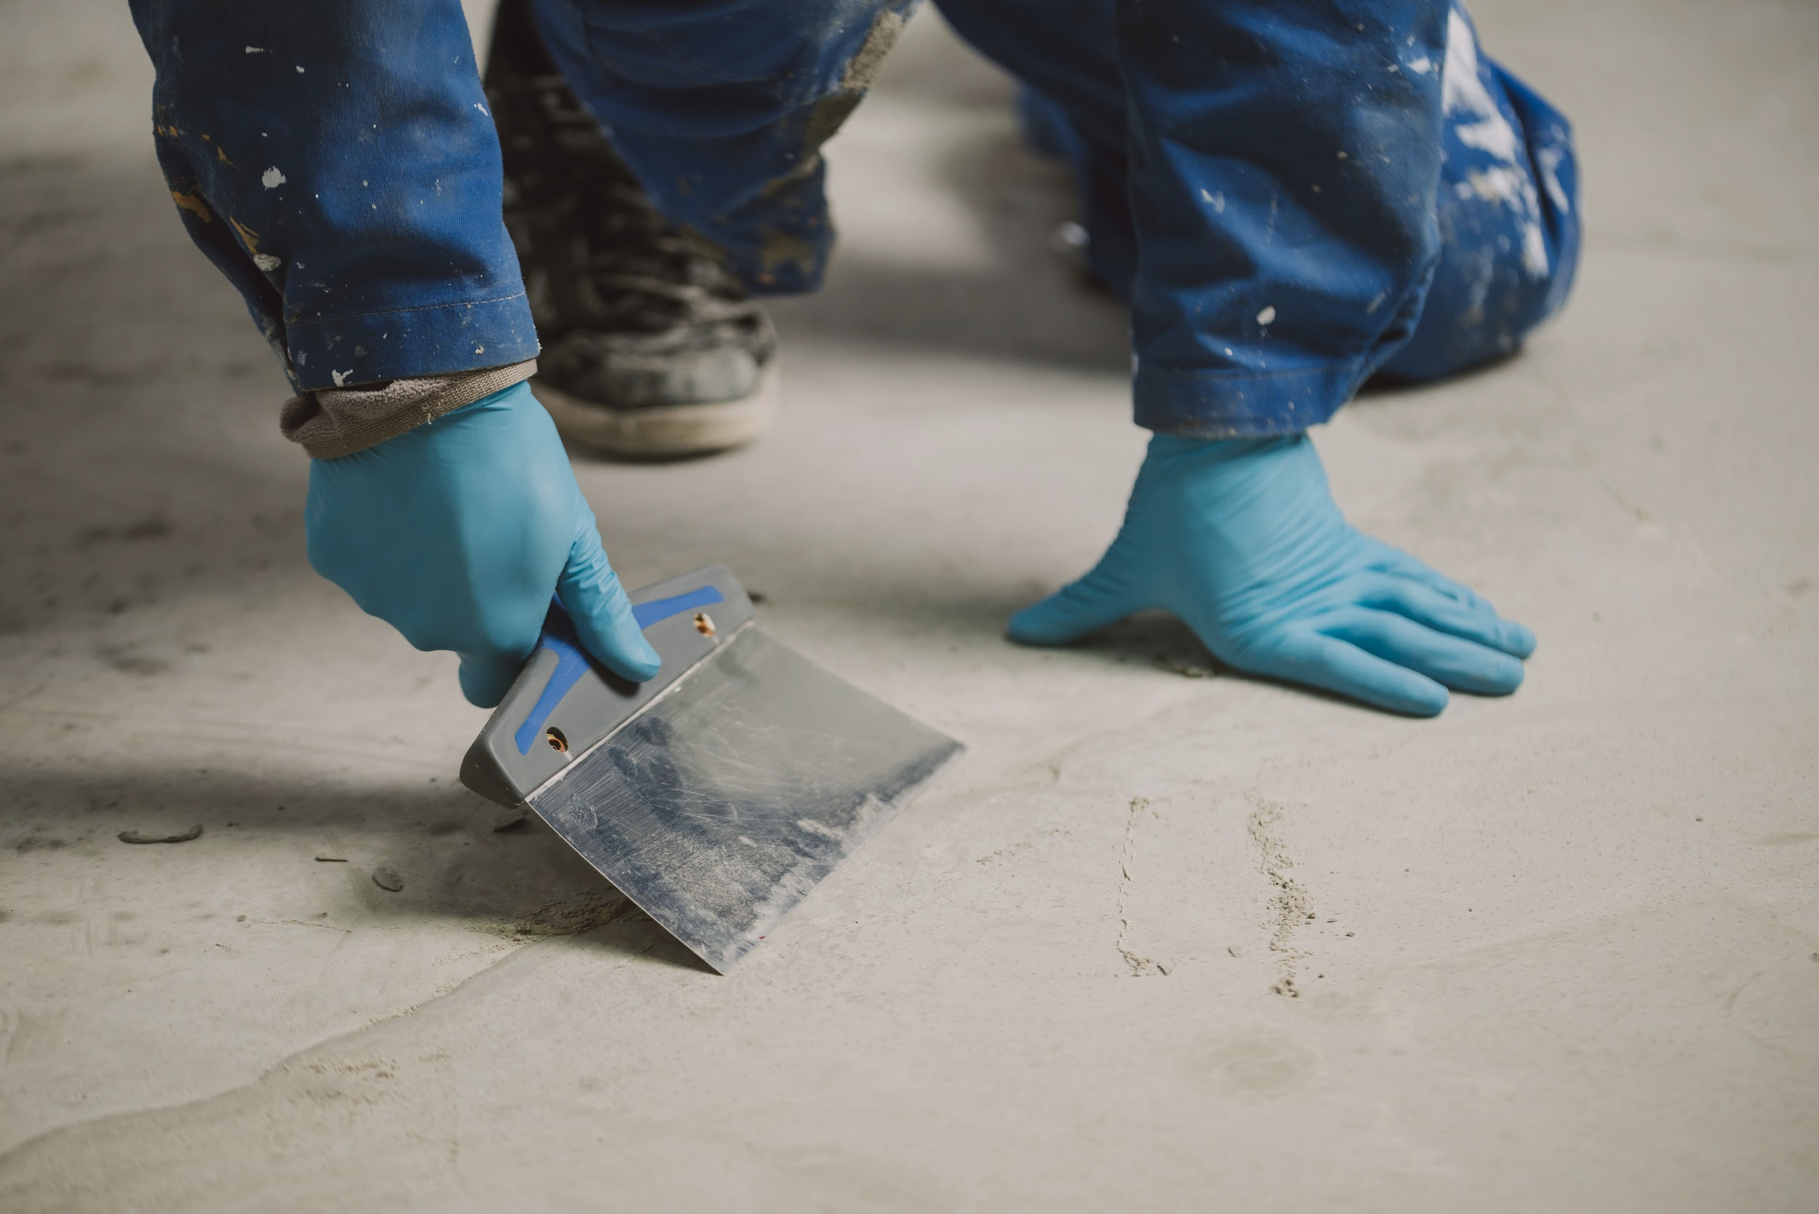
Our Audience
Training Academies
Corporate Partners
Independent Learners
01
03
Student toolkit
02
Employee mobile solution.
Learning journey starting point.

Slide 8
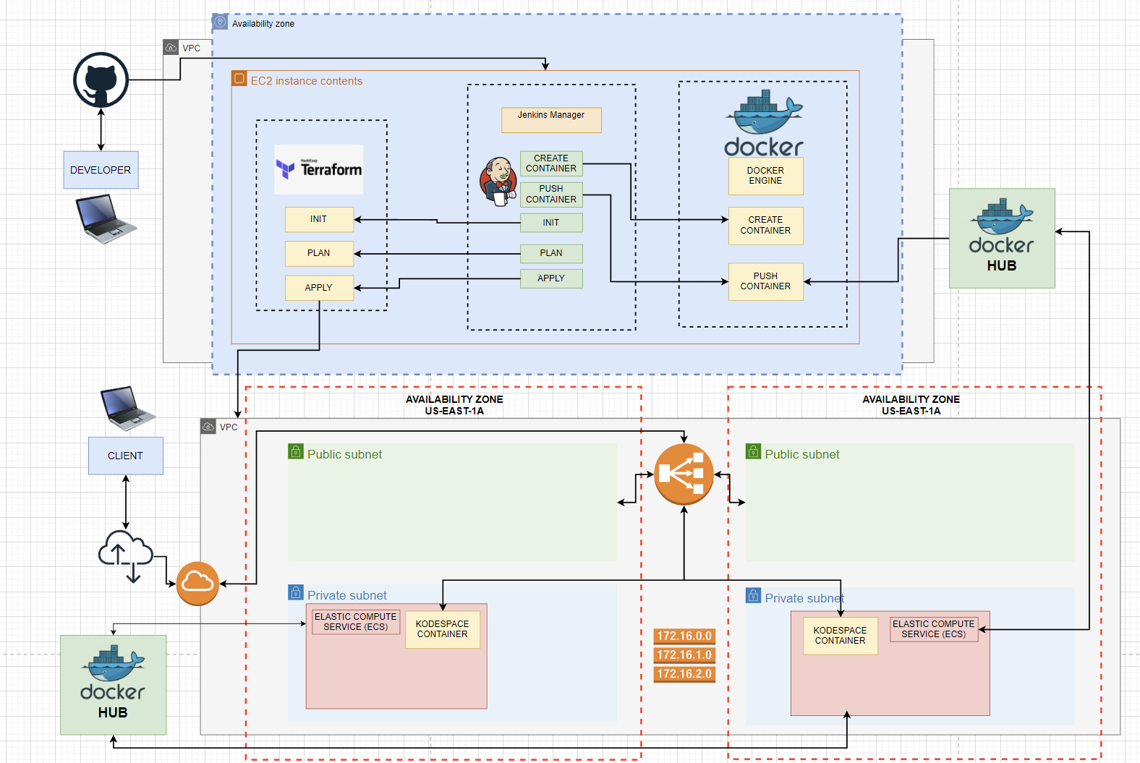
System Architecture

Slide 9
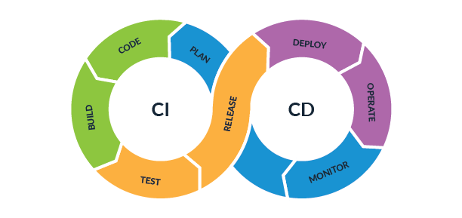
Our Process
Project Management
Containerization
Production Environment
Deployment Tool
Infrastructure as Code
Alerting and Monitoring
Projects, source code…
Containerization strategy…
Load balancers, auto scale groups.
Jenkins
Terraform
Cloudwatch
Github
Docker
AWS
Pipeline….
Build…
Notifications

Slide 10
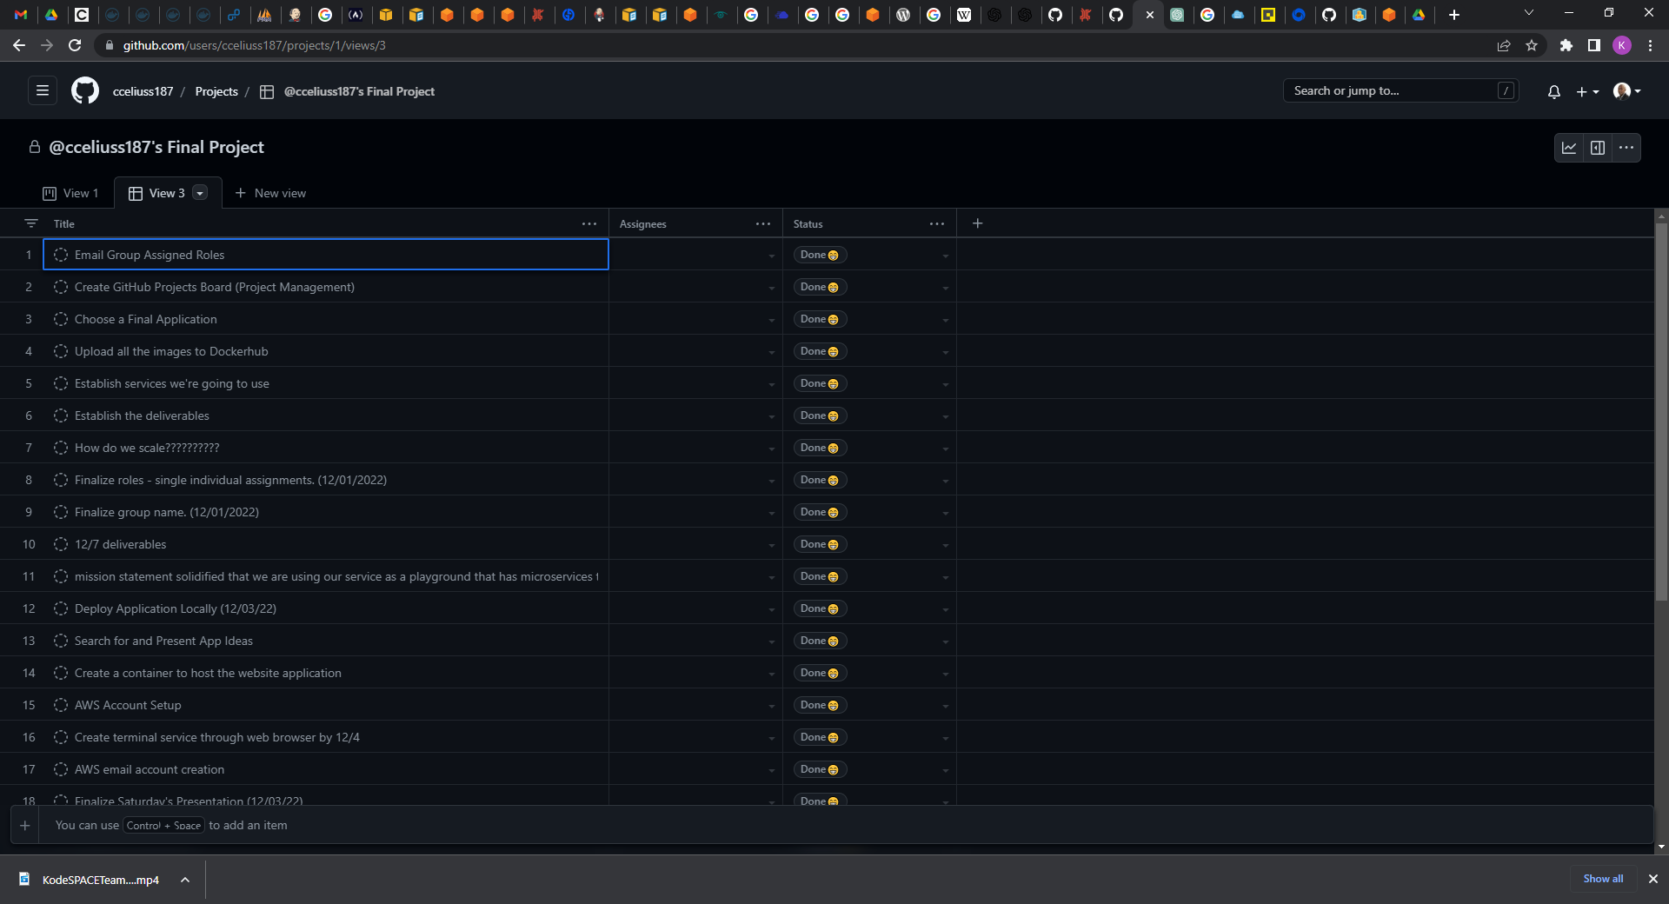
Github - Project

Slide 11
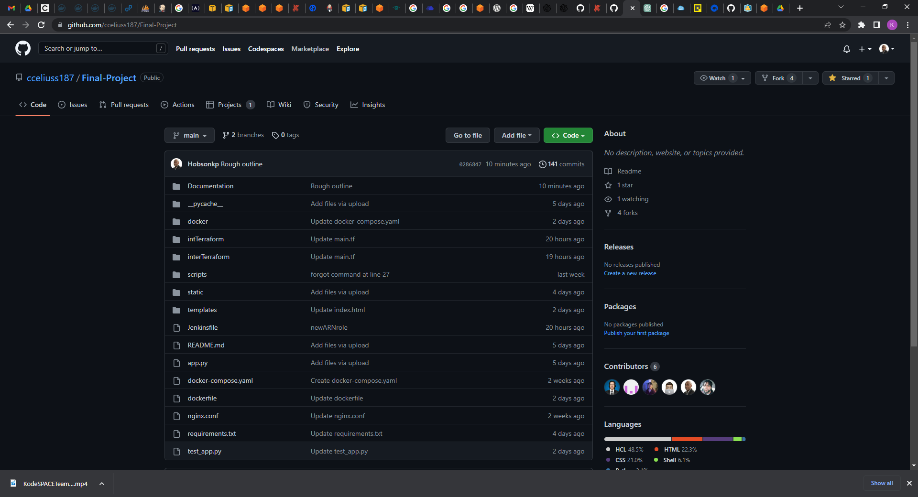
Github - Repository

Slide 12
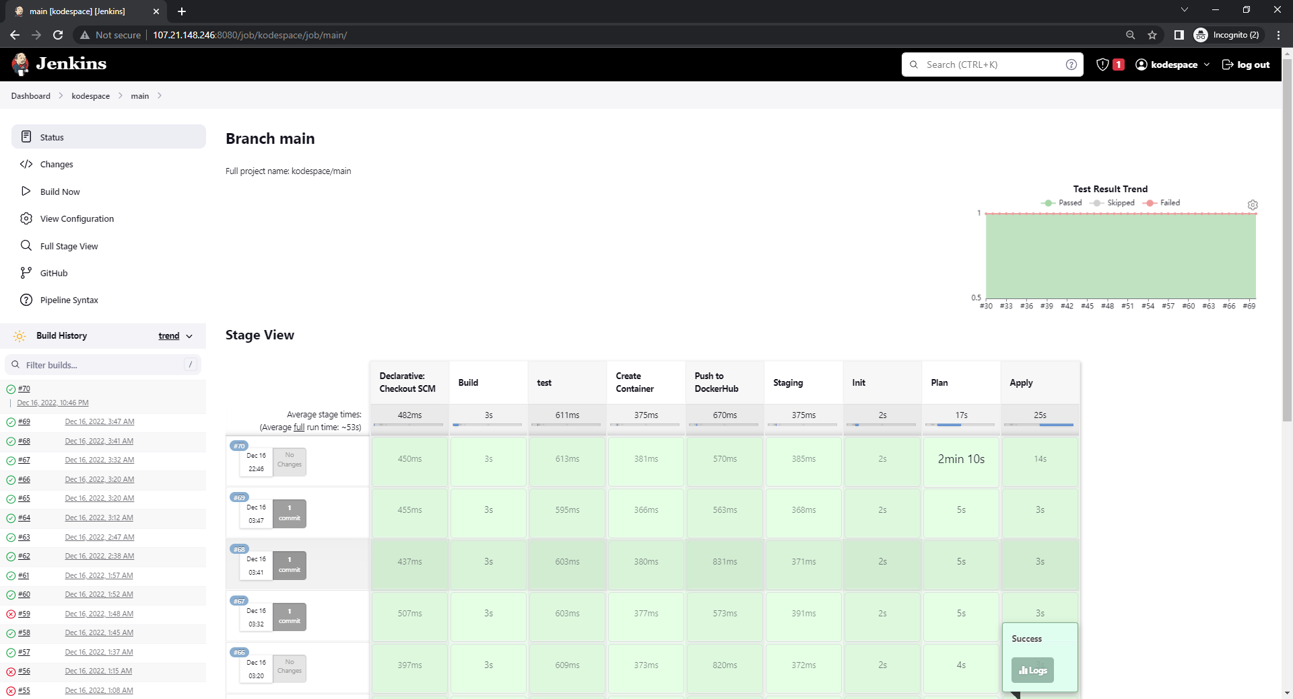
Jenkins

Slide 13
Docker

Slide 14
Terraform

Slide 15
ECS

Slide 16
Cloudwatch

Slide 17
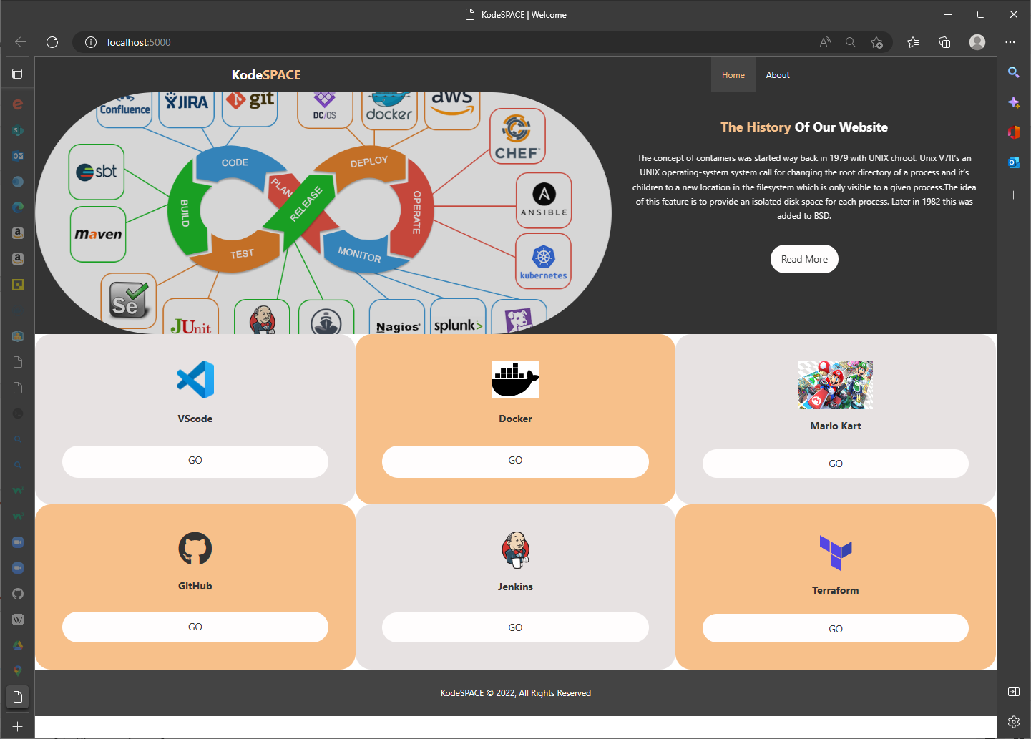
Application

Slide 18
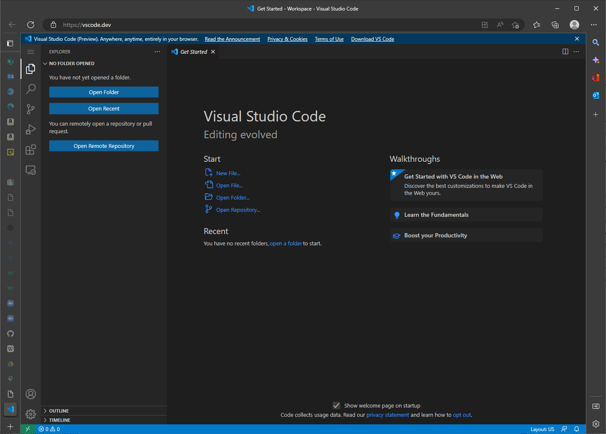
Application

Slide 19
Application

Slide 20
Application

Slide 21
Application

Slide 22
Application

Slide 23

Application

Slide 24
Future Vision
Upgrades and improvements.
01 | Subscriptions Services
02 | ???
03 | ???
04 | ???
05 | ???

Slide 25
Thank you.

